Slide 1
Get on Mission

Slide 2
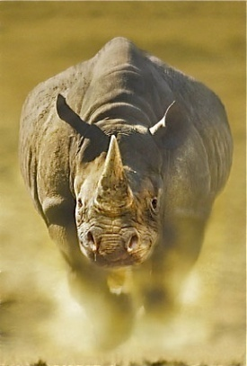
Get on mission
What was the message of Jesus?
“The Kingdom of God has come near. Repent and believe the good news!” (Mark 1:15)
The kingdom of God is the reversal of everything that went wrong with the world when sin entered the world. (Salvation; healing; deliverance; freedom)

Slide 3
Run with Passion
Non Followers
Contributors
Core Followers
Consumers

Slide 4
Get on mission
Core followers get on Kingdom mission. They are vision carriers for the Kingdom of God. They are passionate about His cause on the planet.
Let’s take a closer look at the method Jesus used to advance His Kingdom mission.

Slide 5
Get on mission
First, core followers demonstrate the Kingdom Mission with an other worldly love. (Luke 15)
When our hearts are right with God, and the fire of the Spirit is burning bright, the things that matter to God matter to us. (e.g., family & God’s family)

Slide 6
Get on mission
Second, core followers demonstrate the Kingdom Mission with an other worldly power. Mark 16:15f, “Go into all the world and preach the gospel to all creation . . . And these signs will accompany those who believe: In my name they will drive out demons; they will speak in new tongues; they will pick up snakes with their hands; and they will drink deadly poison, it will not hurt them at all; they will place their hands on sick people, and they will get well.”

Slide 7
Get on mission
Second, core followers demonstrate the Kingdom Mission with an other worldly power. (Mark 16:15f)
What about seekers? (Scooby Doo theory; Wicca; psychics; trouble kids) (e.g., psychologists & freedom; healing)
“But, I can’t.” (Matthew 10)

Slide 8
Get on mission
Second, core followers demonstrate the Kingdom Mission with an other worldly power. (Mark 16:15f)
Jesus was fully human, just like us. In John 5:19, Jesus said, “Very truly I tell you, the Son can do nothing by himself; he can do only what he sees his Father doing.”

Slide 9
Get on mission
Second, core followers demonstrate the Kingdom Mission with an other worldly power. (Mk 16:15f)
John 14:12-14, “Very truly I tell you, all who have faith in me will do the works I have been doing, and they will do even greater things than these, because I am going to the Father. And I will do whatever you ask in my name, so that the Father may be glorified in the Son. You may ask me for anything in my name, and I will do it.”

Slide 10
Get on mission
Second, core followers demonstrate the Kingdom Mission with an other worldly power. (Mk 16:15f)
When Jesus is present, lives are changed. It’s not about us. It’s about Jesus.

